Slide 1
Image tiling library
Under supervision:
Dr:Khaled fathy
Prepared by:
ereene mahrous Mikhail
Section: 1

Slide 2
Image_tiling
The example presents the following operations on the tiled images:
1-simple point-wise operation
2-filtering
3-rotation
4-resizing

Slide 3
Processing Tiled Images
Tiled image is an image that is stored or represented by its parts, called tiles. Thus, a tile is some part of an image, and all tiles are assumed to be of the same size.
The particular method used for storing the tiles can be arbitrary. In certain cases, for example, to save memory, it is convenient to process an image tile-by-tile.
When an image processing function performs a point-wise operation (for example, image arithmetic or logical operation), it can be directly applied to processing a tiled image.
On the contrary, when an operation (such as filtering) requires pixels outside the tile, or when input tiles are not mapped to the output tiles (such as in geometric transforms), processing the tiled images becomes more complicated and requires additional efforts.
Accordingly, we shall consider the following cases of tiled image processing by means of Intel IPP functions:

Slide 4
Function of tiled image:
Case 1: Image is processed using a point-wise operation – for example, logical operation Xor.
In this case, all the required input pixels are given. Moreover, each tile of an input image is
mapped to the corresponding (that is, having the same coordinate position) tile of the
output image;
Case 2: Image is processed using a neighborhood operation that needs intensity values for
pixels outside the tile – for example, lowpass filtering operation Blur. In this case, each tile
of an input image is also mapped to the corresponding output tile, but not all required
input pixels are given and thus the additional (border) pixels must be set;

Slide 5
Function of tiled image:
Case 3: Image processing operation works in such a way that pixels of an input tile are not mapped to the spatially corresponding output tile - for example, image resizing. In this case certain parameters (resize factors) must be recalculated to combine correctly the
output tiles.
Case 4: Image processing operation needs intensity values for pixels outside the tile, and input tiles are not mapped to the spatially corresponding output tiles - for example, image rotation. Here the intensity values of pixels that lie outside the input tile are required to compute intensity values of the boundary pixels using linear or cubic interpolation. In this case, the algorithm must account for both proper tile mapping and border pixels setting.

Slide 6
The "Butler" Class
First things you need to process images tile-by-tile are the functions for reading and writing
the tiles.
The class named "Butler", which serves to supply the image processing operation with
image pixel data, was specially developed to simplify the tiled image processing by Intel
IPP primitives. The main methods of the class are the functions for retrieving data from the
tile and for storing data into the tile. Besides that, the Butler class performs tile storage,
which can reside either on the hard disk, in system memory, on the network, in a
bitstream, or elsewhere.
The typical procedure of tiled image processing using the Butler class should generally
look like the following :
while( tile index is inside of dst image ) {
srcTile = srcButler.getTilePtr( index );
dstTile = new tile;
// process the tile
dstButler.putTilePtr( dstTile, index );
index = dstButler.incIndex( index );
}

Slide 7
Methods of the class:
Two methods of the class are designed to create test images. The method
createTiledImageRamp creates the tiled image with monotonously increasing brightness.
The method createTiledImageGrid creates the grid with the variable line width. These
methods can serve as another illustration of the tiled image processing implementation. For
example, the method createTiledImageRamp uses the Intel IPP primitive ippiImageRamp
as follows:
while( index.inside( m_imgSz ) && ippStsNoErr==st ) {
Ipp8u* tile = new Ipp8u[Tile::size().area()*3];
ippiSet_8u_C3R( white, tile, Tile::wstep(), Tile::size() );
float ofs = index.x * Tile::side() * slope;
st = ippiImageRamp_8u_C3R( tile, Tile::wstep(),
sizeToProcess(index), ofs, slope, ippAxsHorizontal );
putTilePtr( tile, index );
index = incIndex( index );
}

Slide 8
Derived Classes
Three classes derived from the Butler classes are implemented in the example code. All
derived classes, ButlerReflect, ButlerRotate, and ButlerResize, are designed to
provide the special implementation of the function copyTiles that creates an array of input
pixels.
The classes ButlerRotate and ButlerResize are required in geometric transforms, since
for such transforms the Butler class must provide a different method of creating the input
array as compared to filtering operations.
The class ButlerReflect is designed to demonstrate how to set the non-existent border
pixel values in a more appropriate way than just to fill them with zeros. For example, in the
figure below, the added pixel values (blue) beyond the vertical boundary of the image
(yellow) may be obtained by mirroring the existing pixels (black) .
b a a b c
e d d e f
To mirror the pixels, the Intel IPP function ippiMirror with appropriate values of the
parameter flip is used.

Slide 9
Auxiliary Classes
Example code declares and uses several auxiliary classes that simplify coding. These
classes are Size, Rect, and Index that are built atop the corresponding Intel IPP structures
IppiSize, IppiRect, and IppiPoint. Several constructors for each class allow to easily
create variables of these types including the range of function parameters' definition.
The Index class contains some helpful and widely used methods, for example, the method
inside that checks if the tile is inside the image, and an operator that adds indices. A
special method offcenter computes the value, which must be added to the image data
pointer in order to reset it to point to the first pixel of the specified tile.
The Tile class was designed specifically to substitute data of the non-existent tile, so when
the required tile does not exist, the “black” tile with zeroes is returned.
Note that example code uses square tiles, but this does not impose restrictions on using
rectangular tiles of any size.

Slide 10
Visualization Procedure
To visualize the processing results, the special function was developed that creates a new
window and draws the resulting image using Windows* API. This function is auxiliary and is
not described in detail here. However, its interface and usage tips may be of interest to
developers.
The interface is typical for the Intel IPP primitives and contains the pointer to the actual
image data, step in bytes through the image, and the size of the region of interest (ROI) as
follows:
void* ipView_8u_C3R(const Ipp8u* pData, int step, IppiSize roi,
const char* caption, int isModalView);
The last two parameters passed to the function are the string that will be the window
header, and the window modal flag. If this flag is set, then the created window becomes
modal. It means that the application pauses after the image is drawn and resumes
operation only after the window is closed. This option can be used to conveniently create
several windows, for example, with input and output images, by setting the modal flag only
for the output image window.

Slide 11
Example 1: A Point-wise Operation on a Tiled Image
A point-wise processing is the easiest type of operation on a tiled image. The following
example implements the point-wise test function t_xorc, which uses the Intel IPP
primitive ippiXorC and is so simple that its code may be given below:
int t_xorc( int w = 300, int h = 200 ) {
Butler srcButler;
srcButler.createTiledImageRamp( w, h );
Butler dstButler( w, h );
Ipp8u val[3] = { 255, 255, 0 };
Index index;
while( index.inside( dstButler.imageSizeTiles() ) ) {
Ipp8u* srcTile = srcButler.getTilePtr( index );
Ipp8u* dstTile = new Ipp8u[Tile::size().area()*3];
ippiXorC_8u_C3R( srcTile, Tile::wstep(), val, dstTile,
Tile::wstep(), dstButler.sizeToProcess(index) );
dstButler.putTilePtr( dstTile, index );
index = dstButler.incIndex( index );
}
srcButler.draw( " original", 0 );
dstButler.draw( " xored", 1 );
return 0;
}

Slide 12
Example 1: A Point-wise Operation on a Tiled Image
You can see a typical loop for tile processing. In each iteration, the function takes an input tile using the Butler class, creates an output tile, and processes the input tile as if it was a whole image.
Note that the region of interest (ROI) passed to the function is created such as to accommodate for the possible image boundary presence.
After processing, the function stores the output tile, increments the tile index and repeats iteration.
When the whole image is processed, the function draws the source image in a non-modal window and

Slide 13
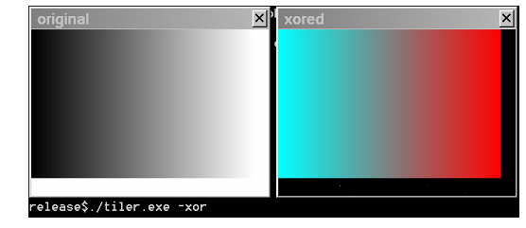
Figure 1. Point-wise Operation on the Tiled Image

Slide 14
Example 2: Tiled Image Filtering
The lowpass filter function ippiFilterBox is an example of a neighborhood operation that
requires border pixels. To compute pixel values on the edge of the tile, the function needs
pixels outside the tile. If the input tile lies inside the image, the required pixels are taken
from the neighbor tiles, but if the function needs pixels outside the input image itself, then
the image border that contains the missing pixels is created.
There are several ways that can be used to specify values of these border pixels. The
simplest is to set pixel values to zero, which is implemented in the method copyTile of the
base class Butler. Another option (implemented in the class ButlerReflect ) is to mirror
pixels of the existing boundary tile by using the Intel IPP primitive ippiMirror. You may
also want to develop your own border extension model, for example Copy, using the new
method copyTiles in the derived class ButlerCopy.

Slide 15
Example 2: Tiled Image Filtering
The example code is again rather simple. In the loop through all tiles, the code determines
the rectangle of input pixels that are necessary to compute all pixels of the current tile as:
bound[0][0] = dstTileIndex.x * Tile::side() - (masksz - anchor.x);
bound[0][1] = dstTileIndex.y * Tile::side() - (masksz - anchor.y);
bound[1][0] = bound[0][0] + Tile::side() + masksz -1;
bound[1][1] = bound[0][1] + Tile::side() + masksz -1;
Here the boundaries of the area for input pixels are extended to add the distance to the
filter mask anchor point. After that, the array of input pixels is retrieved for processing:
Ipp8u* srcTiles = srcButler.copyTiles( dstTileIndex,
srcButler.howManyTiles(bound), &wstep);
Next, the input array is processed and the results are written to the output tile:

Slide 16
Example 2: Tiled Image Filtering
st = ippiFilterBox_8u_C3R( srcTiles+Index(1).offcenter(
Tile::size(),wstep),wstep, dstTile, Tile::wstep(),
dstButler.sizeToProcess(dstTileIndex), maskSz, anchor );
Finally, the output tile is saved, tile index is increased, and the memory allocated for the
array is freed:
dstButler.putTilePtr( dstTile, dstTileIndex );
dstTileIndex = dstButler.incIndex( dstTileIndex );
ippiFree( srcTiles );
The distinctive feature of this code example is the possibility to specify the type Butler
that will service filtration. To accomplish this, the test function
t_blur is declared as
follows:
int t_blur( Butler& srcButler, int masksz=3, int w=320, int h=256 )
The call to this function may look like the following:
t_blur( ButlerReflect(), 7, w, h );

Slide 17
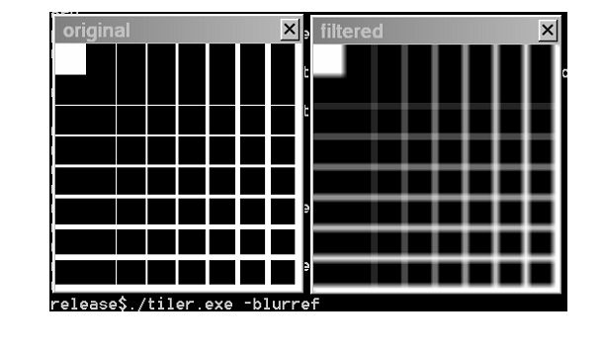

Slide 18
Example 3: Rotation of the Tiled Image
The example of the geometric transform is the most complicated because additional efforts
are needed to determine the input image processing areas for each tile. However, the
general approach remains the same: for each output tile, create a two-dimensional array
containing pixels of all tiles needed to compute the current output tile, then process the
array, store the output tile, and increase the tile index.
It is important to note that in the call to the Intel IPP primitive
ippiRotate, pointers to
the input and output data are offset as if the function operates on the full image. But in
actual fact these pointers (passed as parameters to the function) point to the non-existing
data:
st=ippiRotate_8u_C3R(srcTiles-startTile.offcenter(Tile::size(),wstep),
imgSz, wstep, srcRect,
dstTile-dstTileIndex.offcenter(Tile::size(),Tile::wstep()),
Tile::wstep(), tileRect,
angle, xshift, yshift, interpolation );

Slide 19
Example 3: Rotation of the Tiled Image
The positions of processing areas srcRect and tileRect are also set on the assumption
that the input and output images are full size. Again, the actual situation is different. For
example, a single tile of the image is used as the output buffer, and the pointer to it is
reset inside the function when the tile position in the output image is accounted for (at this
stage, the complete output image does not exist). It means that the function which sets
the pointer to the output buffer will compensate the initial negative offset by the adequate
positive offset.
This manipulation with pointers to non-existent data is caused by the specifics of function
interface and makes it possible to accomplish the tile-by-tile image processing in the
described case.

Slide 20
Example 3: Rotation of the Tiled Image
It should be specially noted that before entering the loop, the shift values for forward and
inverse geometric transforms are calculated. Shift values for a forward transform are used
by the Intel IPP function. Shift values for an inverse transform are used for computing the
processing area of the input image:
srcButler.rectToBound(tileRect,bound,-angle,xshiftback,yshiftback);
Rect srcRect = srcButler.boundToRectBorder( bound, 3, 6 );
Values 3 and 6 specify the parameters of the border that is used during interpolation. As
soon as the input image rectangle is determined, the code retrieves the array of pixels for
processing:
Ipp8u* srcTiles = srcButler.copyTiles( startTile,
srcButler.howManyTiles(bound), &wstep );
Finally, pixels in the array are processed (in the discussed case, some part of the source
image is rotated) and a single output tile is obtained. Figure 3 shows the source and the
output (rotated) images.

Slide 21
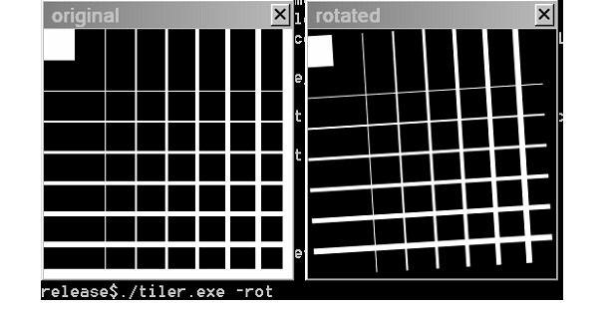
Figure 3. Rotation of the Tiled Image

Slide 22
How to Make the Tile Grid Visible
If you want to make the tile boundaries visible in the example of image rotation, it will
require adding two lines of code and modifying one line. First, decrease by one point the
output ROI size before processing the image as:
tileRect.width--;
tileRect.height--;
and then replace the test image with the image that has more bright points:
srcButler.createTiledImageRamp(w,h);
Now the grid that is formed by the tiles is visible on the output image (see Figure 4).

Slide 23
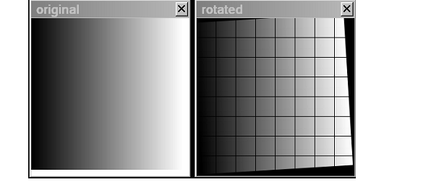
Figure 4. Visualization of the Tile Boundaries

Slide 24
Example 4: Resizing of the Tiled Image
Two special functions - ippiResizeShift and ippiGetResizeFract - have been developed
for this operation.
The processing scheme is very similar to the previous example, but the shift values xshift
and yshift are computed for each tile by the function ippiResizeShift that is called
directly in each iteration. The function uses the recalculated values of the resize factors
that must be computed by calling the function ippiGetResizeFract beforehand.
Figure 5 shows the source and the output (resized) images.

Slide 25
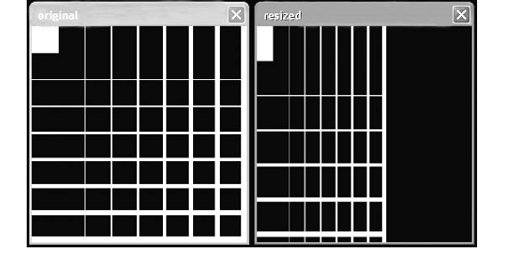
Figure 5. Resize of the Tiled Image

Slide 26
Running the Test
All four examples are contained in the single executable file.
Each example is invoked from the command line by typing the test reference name.
The following table lists commands that invoke the examples, together with available operation modes, as well as Intel IPP primitives and Butler class types used.

Slide 27
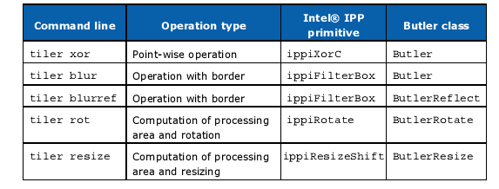
Running the Test

Slide 28
Running the Test
Note that the image size, filter parameters, or geometric transform parameters are not
specified in the command line. Their values are fixed to make the example more compact.
However, you can easily change values of these parameters in the example code and
rebuild the example.

Slide 29
Thanks

